Slide 1
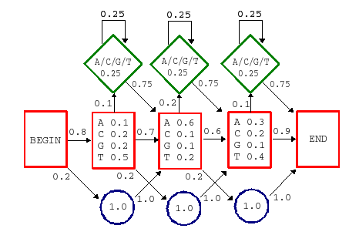
Hidden Markov Model
Lecture – 9
Department of CSE, DIU

Slide 2
CONTENTS
Markov Chain Model
- Markov Chain Model: Notation
2. Probability of a Sequence for a Given Markov
Chain Model
CpG Island
4. Hidden Markov Model
- Forward Algorithm
- Viterbi Algorithm

Slide 3
1. Markov Chain Model
Design of a Markov Chain Model

Slide 4
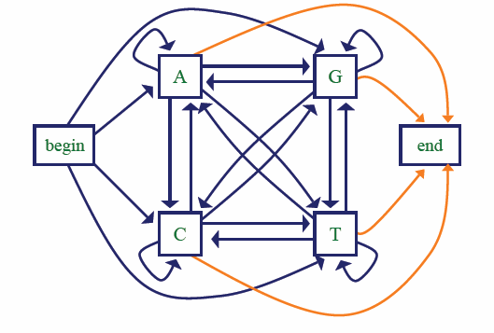
Markov Chain Model
A Markov Chain Model is defined by a set of states (A,C,G,T) and a set of transitions associated with those states.

Slide 5
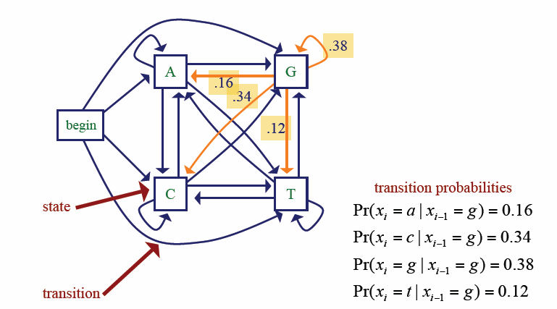
Markov Chain Model
Each and every transition from one site to another (A to G, C to A etc.) will occur with some transition probability (Will be given in Question as a Chart)
There will be given a specific probability value for each transition from ‘Begin’ to all other sites (Begin to A, Begin to C etc.)
If no transition value is given for Begin, then assign (1/4) = 0.25 to each of the transitions (Begin -> A, Begin -> C, Begin -> G, Begin -> T)
Same will be applicable for all transition to End (not shown in this picture, but shown in the previous slide’s picture)

Slide 6
Markov Chain Model: Notation
the transition parameters can be denoted by a
where
^{x}i−1 ^{x}i
a = Pr(x | x )
^{x}i−1 ^{x}i
i i−1
similarly we can denote the probability of a sequence x as
L
= Pr(x₁ )∏ Pr(x_{i} | x_{i−1} )
L
^{B x}1 ∏ ^{x}i−1 ^{x}i
a a
i=2 i=2
where a
represents the transition from the begin state
B x_{i}

Slide 7
2. Probability of a Sequence for a Given Markov Chain Model
Calculate the probability of a given sequence using Marcov Chain Model

Slide 8
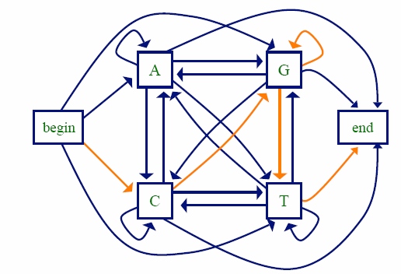
Calculate the Probability of a given sequence
P (C|A)
 | A | C | G | T
A | .18 | .27 | .43 | .12
C | .17 | .37 | .27 | .19
G | .16 | .34 | .38 | .12
T | .08 | .36 | .38 | .18
P(CGGT) = P(C | begin) P(G | C) P(G | G) P(T | G) P(end | T)
= 0.25 x 0.27 x 0.38 x 0.12 x 0.25
= 0.0007659

Slide 9
3. CpG Island

Slide 10
CpG Island
Written CpG to distinguish from a C≡G base pair
CpG dinucleotides are rarer than would be expected from the independent probabilities of C and G.
– Reason: When CpG occurs, C is typically chemically modified by methylation and there is a relatively high chance of methyl-C mutating into T
A CpG island is a region where CpG dinucleotides are much more abundant than elsewhere.
High CpG frequency may be biologically significant; e.g., may signal promoter region (“start” of a gene).

Slide 11
Markov Chain for Discrimination
suppose we want to distinguish CpG islands from other sequence regions
given sequences from CpG islands, and sequences from other regions, we can construct
a model to represent CpG islands (model +)
a null model to represent other regions (model -)
can then score a test sequence by:
_{score(x) = log} Pr( x | model+)
Pr(x | model - )

Slide 12
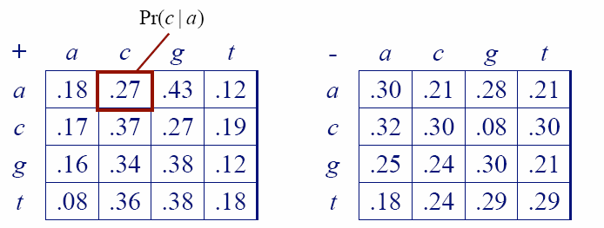
Markov Chain for Discrimination
parameters estimated for + and - models
human sequences containing 48 CpG islands
60,000 nucleotides
Calculated Transition probabilities for both models

Slide 13
Markov Chain for Discrimination
Calculated the log-odds ratio
score(x) = log ^{Pr(x | model+)} =
L
∑
i=1
a
+
L
∑
i=1
log
x x
=
β
i−1 i
Pr(x | model - )
_{a}−
^{x}i−1^{x}i
^{x}i−1^{x}i
•
^{β}x x
i−1 i
are the log-likelihood ratios of corresponding
transition probabilities
β | A | C | G | T
A | -0.740 | 0.419 | 0.580 | -0.803
C | -0.913 | 0.302 | 1.812 | -0.685
T | -0.624 | 0.461 | 0.331 | -0.730
T | -1.169 | 0.573 | 0.393 | -0.679

Slide 14
4. Hidden Markov Model

Slide 15
Hidden Markov Model (HMM)
Components:
Observed variables
Emitted symbols
Hidden variables
Relationships between them
Represented by a graph with transition probabilities
Goal: Find the most likely explanation for the observed variables

Slide 16
Why Hidden?
we’ll distinguish between the observed parts of a problem and the hidden parts
in the Markov chain models it is clear which state accounts for each part of the observed sequence
in the model above, there are multiple states that could account for each part of the observed sequence
this is the hidden part of the problem
the essential difference between Markov chain and Hidden Markov model

Slide 17
Hidden Markov Model: Notations
States are decoupled from symbols
x is the sequence of symbols emitted by model
– x_{i} is the symbol emitted at time i
A path, π, is a sequence of states
– The i-th state in π is π_{i}
a_{kr} is the probability of making a transition from state k to state r:
a_{kr} =Pr(π_{i} = r |π_{i −1} =k)
e_{k}(b) is the probability that symbol b is emitted when in state k
e_{k} (b ) = Pr(x_{i} = b | π_{i} = k )

Slide 18
Scenario: The Occasionally Dishonest Casino Problem
A casino uses a fair die most of the time, but occasionally switches to a loaded one
– Fair die: Prob(1) = Prob(2) = . . . = Prob(6) = 1/6
– Loaded die: Prob(1) = Prob(2) = . . . = Prob(5) = 1/10, Prob(6) = ½
These are the emission probabilities
Transition probabilities
Prob(Fair → Loaded) = 0.01
Prob(Loaded → Fair) = 0.2
Transitions between states obey a Markov process

Slide 19
An HMM for Occasionally Dishonest Casino
ªkl
0.99
0.80
1: 2: | 1/6 1/6
3: | 1/6
4: | 1/6
5: | 1/6
6: | 1/6
0.01
1: 1/10
2: 1/10
3: 1/10
4: 1/10
5: 1/10
6: 1/2
0.2
e_{k} (b)
Fair
Loaded

Slide 20
Important Questions
How likely is a given sequence?
the Forward algorithm
What is the most probable “path” for generating a given sequence?
the Viterbi algorithm

Slide 21
Problem Statement for Forward Algorithm
For 3 Consecutive dice rolling, the outcome observed:
- 6 (first rolling outcome)
- 2 (second rolling outcome)
- 6 (third rolling outcome)
Now find out the probabilities for each possible combinations of two different types of dices (fair and loaded) which might have produced the outcome (6,2,6). Or how likely is if given a specific sequence?
Example: What is the probability that the consecutive outcomes (6,2,6) were generated from the dice combination (F,L,F), which means, the first dice was Fair and outcome was 6, Second dice was Loaded and outcome was 2 and the Last Dice was Fair and outcome was 6?

Slide 22
How Likely is a Given Sequence?
The probability that the path π₁, π₂,…, π_{L} is taken and the sequence x₁,x₂,…,x_{L} is generated:
L
Pr(x₁ ,K, x_{L} | π₁ ,K,π _{L} ) = a_{0π1} ∏e_{π i} (x_{i} )a_{π iπ i+1}
i=1
(assuming begin/end are the only silent states on path)

Slide 23
How Likely is a Given Sequence?
x = x₁ , x₂ , x₃
= 6,2,6
(1)
Pr(x,π ) = a_{0 F} e_{F} (6)a_{FF} e_{F} (2)a_{FF} e_{F} (6)
= 0.5× ¹ × 0.99 × ¹ × 0.99 × ¹
6 6 6
≈ 0.00227
_{π} (1)
= FFF
(2)
_{π} (2)
Pr(x,π ) = a_{0 L}e_{L} (6)a_{LL} e_{L} (2)a_{LL} e_{L} (6)
= 0.5× 0.5× 0.8× 0.1× 0.8× 0.5
= 0.008
= LLL
(3)
_{π} (3)
= LFL
Pr(x,π ) = a_{0 L}e_{L} (6)a_{LF} e_{F} (2)a_{FL}e_{L} (6)
= 0.5× 0.5× 0.2 × ¹ × 0.01× 0.5
6
≈ 0.0000417

Slide 24


